Slide 1
The 12 Principles of Animation
Digital Media 1
Mr. Nicholas Goble

Slide 2
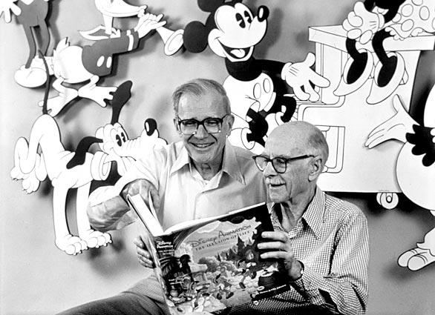
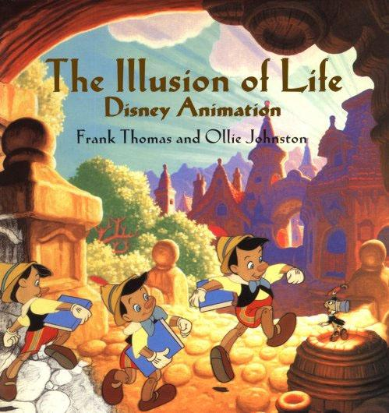
A Dash of History
-Developed by Frank Thomas & Ollie Johnston at Walt Disney in the 1930’s
-Came about thru reflection about Animation and how to make it seem more “real”
-How to better express character and personality

Slide 3
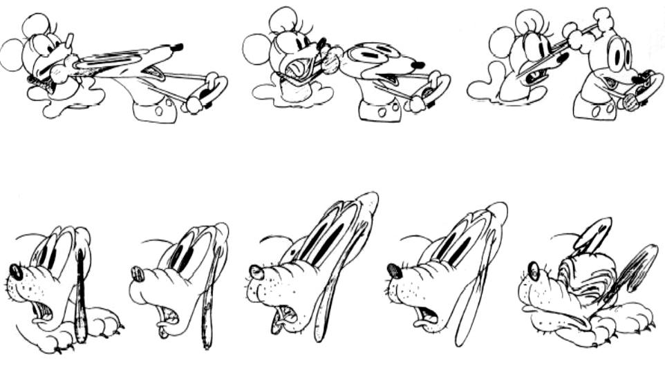
Rule #1 Squash and Stretch
-This action gives the illusion of weight and volume to a character as it moves.
-Useful in animating dialogue and facial expressions.
-How extreme depends on what’s required in the scene.
-Used from a bouncing ball to a person’s face

Slide 4
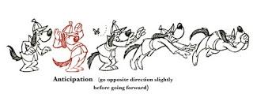
Rule #2 Anticipation
-Prepares audience for a major action the character is about to perform. (Examples: Starting to run, jump, etc.)
-Backwards motion before a forward action is executed.
-Almost all real action has some form of anticipation (Examples: Pitcher’s Wind-Up, Golfer’s Back Swing, etc.)

Slide 5
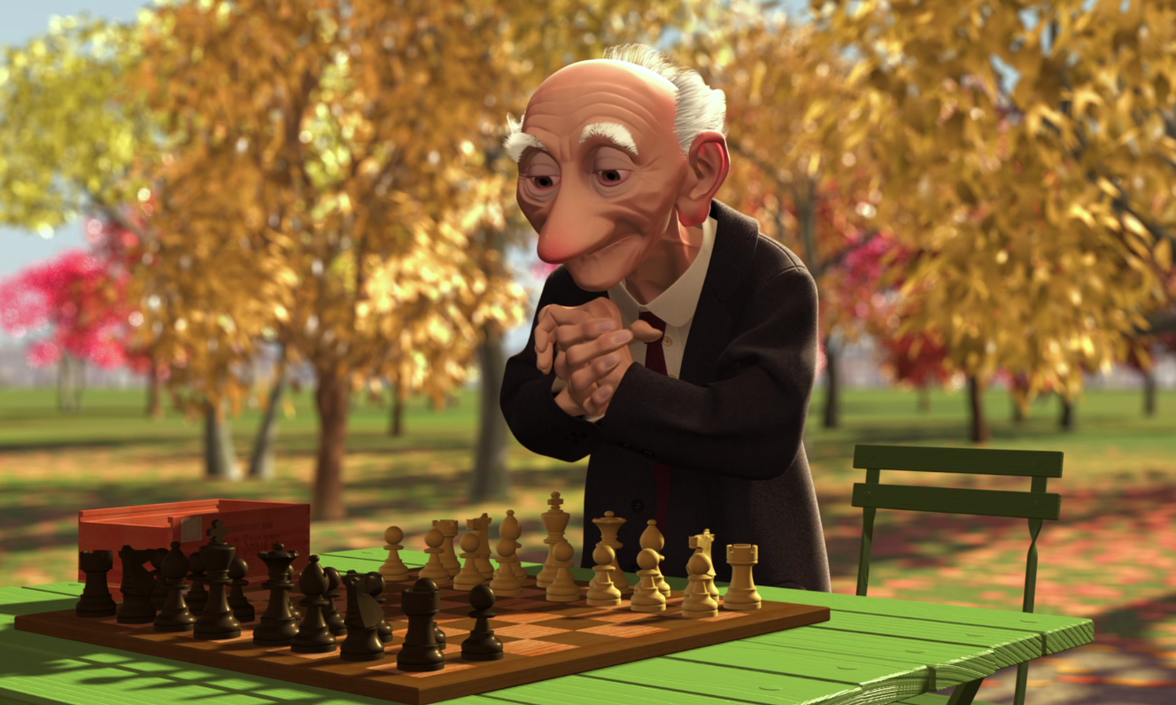
Rule #3 Staging
-Directs audience’s attention to the story being told.
-Make sure the Background works with the Animation
-Pose or action should communicate to the audience the attitude, mood, or reaction of character in relation to story.
-Effective use of Long, Medium, or Close Up Shots and different camera angles.
-Don’t confuse the audience, use one action clearly to get the idea across. (Unless you’re trying to depict clutter/confusion.)

Slide 6
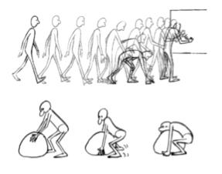
Rule #4 Straight Ahead & Pose to Pose Animation
-Starts at first drawing and works drawing to drawing til the end of the scene.
-Potential loss of size, volume and proportion with this method, but it has spontaneity and freshness.
-Fast and wild action scenes are often done this way.
-Pose to Pose more planned out and charted with key drawings done throughout the scene. (Size, volume, and proportion are controlled better in this method.)

Slide 7
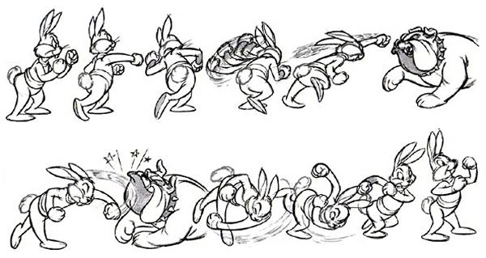
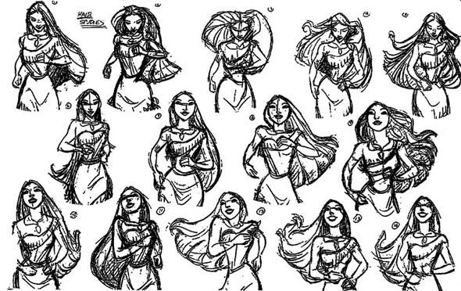
Rule #5 Follow Through & Overlapping Action
-When the main body of a character stops, all other parts continue to catch up to the main mass of the character. (Arms, Long Hair, Clothing, Floppy Ears, or Long Tail)
-NOTHING STOPS ALL AT ONCE
-Drag occurs when character moves in a new direction, and their clothes follow a couple frames later.
-Timing becomes critical to keep a consistent flow.

Slide 8
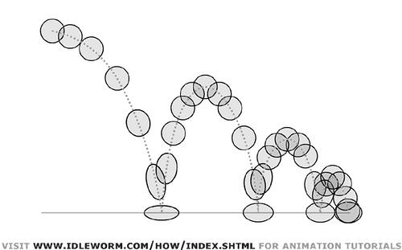
Rule #6 Slow-Out and Slow-In
-As action starts (More drawings near the starting pose, 1 or 2 in the middle, and more near the next pose.)
-Fewer drawings make the action faster.
-More drawings make the action slower.
-SlowOuts and SlowIns soften the action making it more life like.

Slide 9
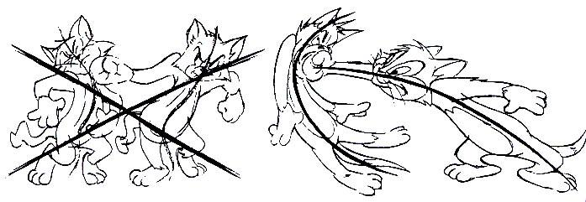
Rule #7 Arcs
-All actions (with a few exceptions) follow an arc or slightly circular path.
-Especially true for the human figure and actions of animals.
-Give animation a more natural action and better flow.
-Examples: Arm movement, Head Turns, Eye Movements

Slide 10
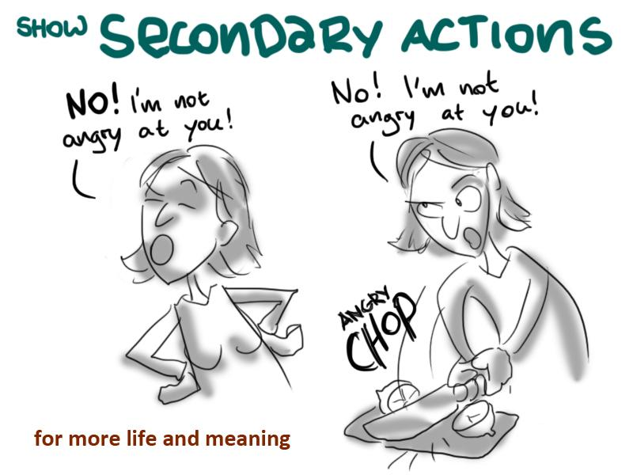
Rule #8 Secondary Action
-Adds to and enriches the main action and dimension of the character
-Example: Character is walking angrily toward someone. The walk is forceful, aggressive, and forward leaning. Secondary action could be strong gestures of the arms with the walk.
-Secondary actions should work with and support the main action.

Slide 11
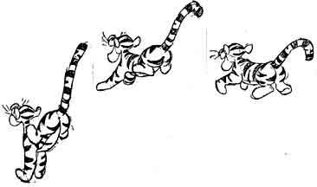
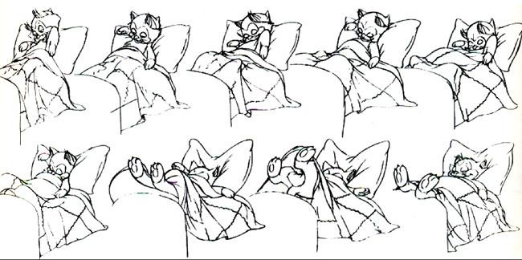
Rule #9 Timing
-More drawings between poses slow and smooth the action.
-Fewer drawings make the action faster and with a snap.
-Studying movement of humans, animals, objects helps make your animation look more realistic.
-Expertise comes from experimentation (Learn by doing and trying. If it doesn’t work, then you learned not to use it for future work.)

Slide 12
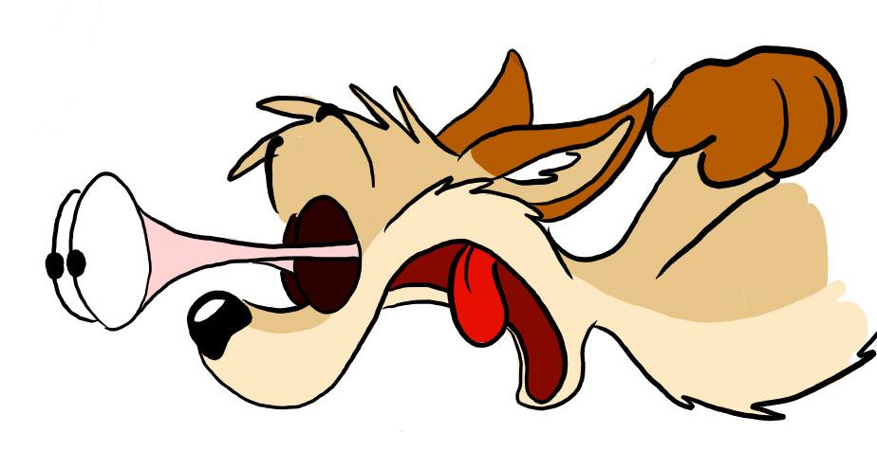
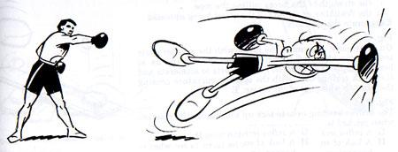
Rule #10 Exaggeration
-Sometimes extreme distortion and broad action helps make a 2D character seem more real with the animation.
-Long drawn out actions make for an exaggeration
-Use of good taste and common sense to make sure you don’t become too theatrical and overlandish.

Slide 13
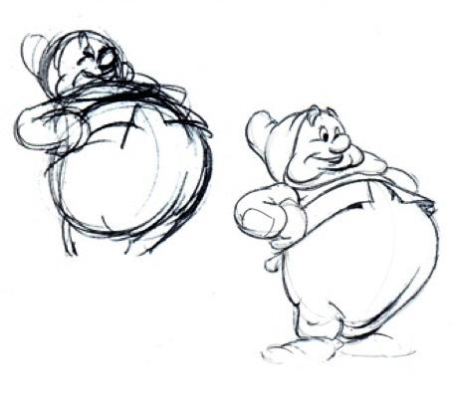
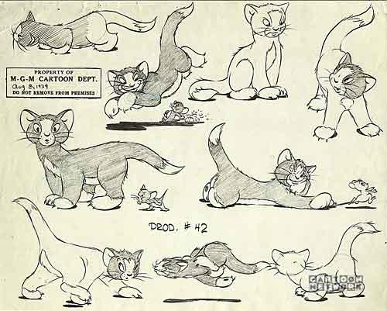
Rule #11 Solid Drawing
-Basic principles of drawing form, weight, volume and the illusion of 3D apply to to animation just as much as academic drawing.
-Three-dimension is the movement in space
-Fourth-dimension is the movement in time.

Slide 14
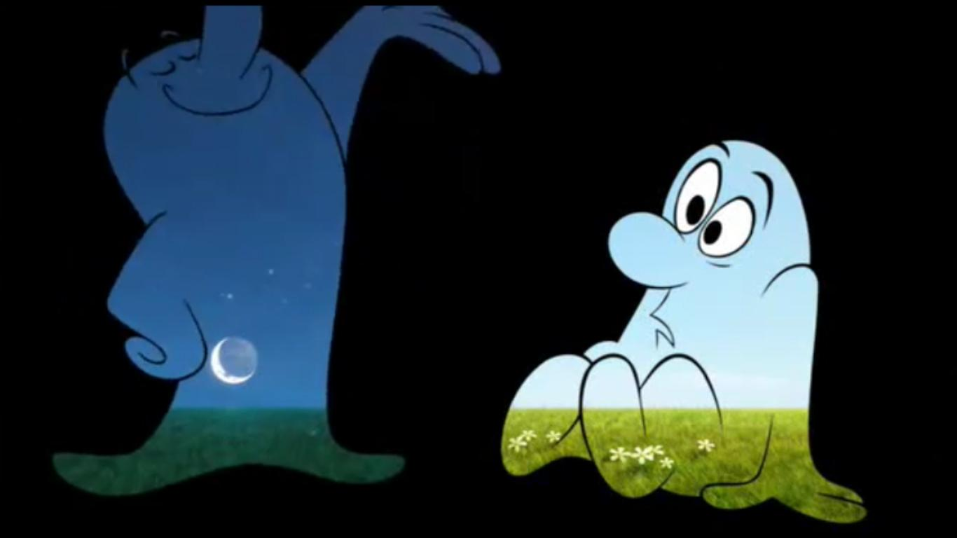
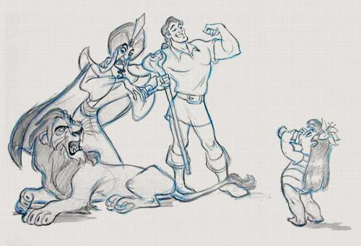
Rule #12 Appeal
-Live performer has charisma/Animated character has appeal
-All characters must have some appeal whether they’re heroic, villainous, comic or cute.
-Personality development for a character makes the audience care about something that exists in an imaginary world.

