Slide 1
Digital Media 1 Photoshop Skills Test
Mr. Nicholas Goble

Slide 2


The Client:
N.C. Department of Agriculture and Consumer Services

Slide 3

The Event:

Slide 4
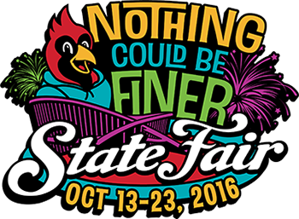
The Theme:
**This is the only photo you’re allowed to use with a background removed!

Slide 5
The Purpose:
Promotional Flyer (Front & Back)
Size Requirements: Half Page - 8.52 Inches x 5.47 Inches
File Types: .PSD (in Portfolio Folder) / .JPEG (Turned in on DropItToMe)
Naming Convention: LastNameFirstNameFairFlyerFront / LastNameFirstNameFairFlyerBack
Alignment: Vertical or Horizontal (Your Choice)
Focus: The theme “Nothing Could Be Finer”, a tribute not only to our State Fair, but also to all things we love about North Carolina.
N.C. State Fair Website: http://www.ncstatefair.org/2016/index.htm

Slide 6
Requirements:
Visual Layout and Hierarchy is displayed through proper use of Design Elements and Principles (x200 Points)
Color Choices & Typography Choices are appropriate to the overall design (x200 Points)
Research has been done on various aspects of the State Fair through the fair’s website and is documented in Student’s Notebook (x200 Points)
All pictures are properly and cleanly cut out from their backgrounds using either layer masks or eraser tool. (x200 Points)
  EXCEPTION: You are allowed TWO (2) images that can be square/rectangular and not cut out!
  Absolutely no images from the web that have been cut out previously, if used you will receive a ZERO (0) for the entirety of the assignment.
5) Total Points for Assignment: 800

Slide 7
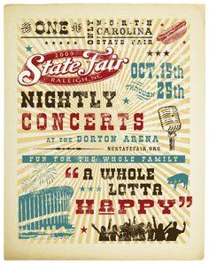
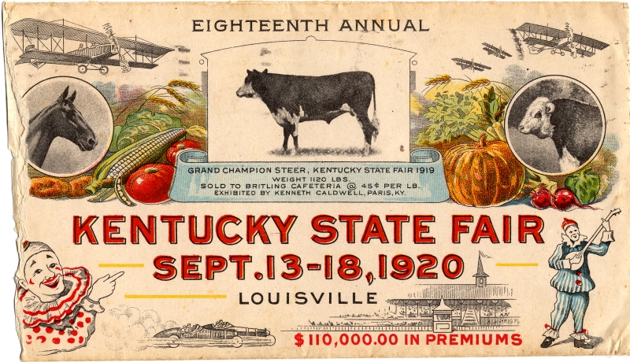
Old School Examples:

Slide 8

Modern Examples:

Slide 9
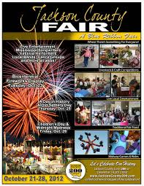

More Modern Examples:

