Slide 1
Objective 101.01 Describe the core concepts of digital media and relationship between digital media, society, and industry certifications.

Slide 2
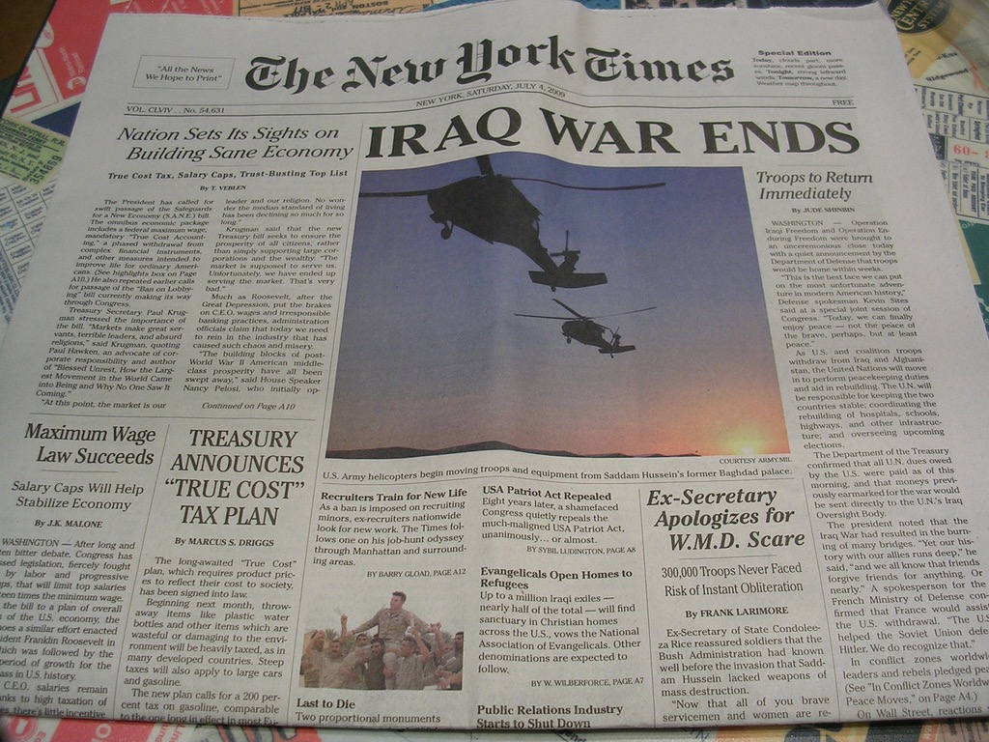
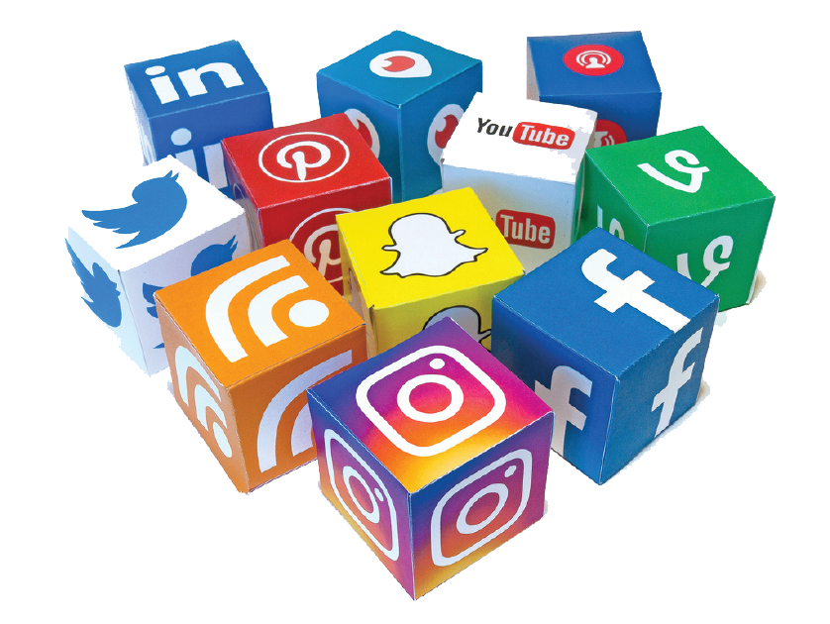
TYPES OF MEDIA
Messages aimed at mass audiences; can be delivered in many forms or methods.
Traditional Media
Social Media
Digital Media

Slide 3
TRADITIONAL MEDIA
Communication that was well-established before the Internet age; books, newspapers, magazines, etc.

Slide 4
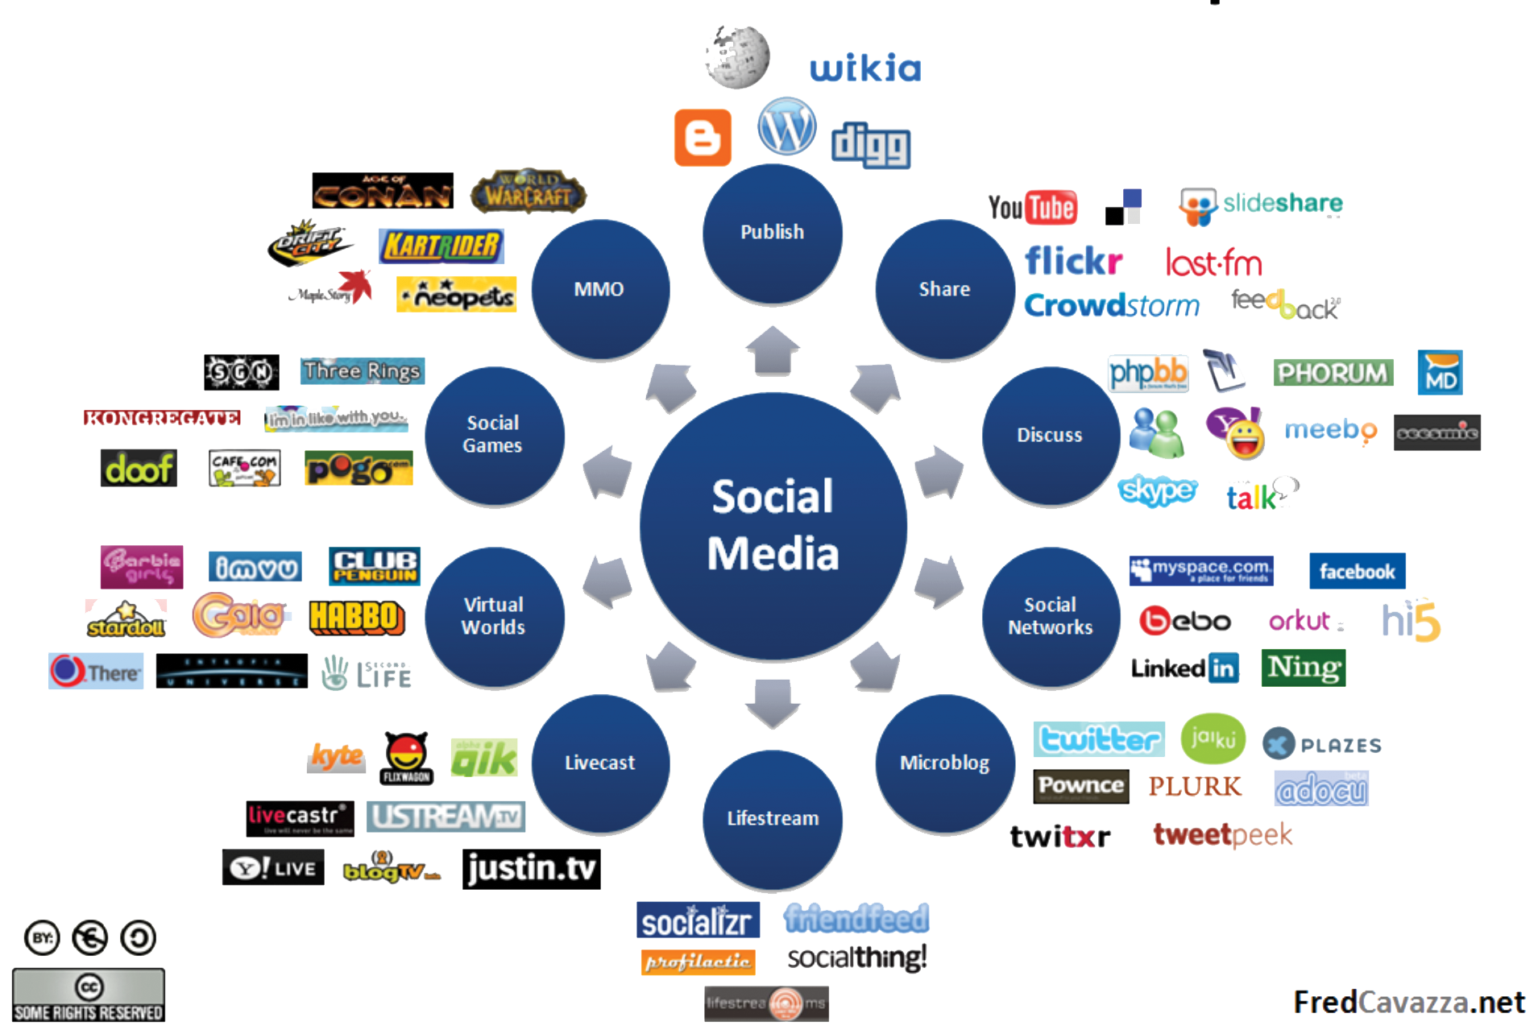
SOCIAL MEDIA
Created and controlled by a community of users that interact using the Internet.

Slide 5
DIGITAL MEDIA
Can be broken down into five major categories for the purposes of this course:
Graphic Design
Animation Development
Audio Production
Video Production
Web Design
The use of creative design and computer technology to combine forms of media to reach the audience in various ways.

Slide 6
QUESTIONS TO CONSIDER
Differentiate between traditional, social, and digital media.
Which do you use the most?
Which do you use the most for education? Entertainment?

Slide 7
DIGITAL MEDIA PROCESS
Pre-production
Defining the parameters of the project and making preliminary decisions about conveying the intended message to the audience.
Production
The active process of using hardware and/or software to create original digital media.
Post-Production
Modifying the project to accomplish the intended purpose; optimizing the output file to meet client’s specific needs.

Slide 8
USES OF DIGITAL MEDIA
Digital media can be used in a variety of settings depending on the message being conveyed and its intended audience.
Commercial
Intended to persuade the audience to use or buy a product; examples include infomercials, advertisements, and other marketing products.
Entertainment
Intended to captivate an audience and keep them engaged; examples include digital art, movies, video games, music, etc.

Slide 9
USES OF DIGITAL MEDIA
News/Informational
Informs the audience about recent events and/or topics; examples include news casts, online periodicals, etc.
Public Service Announcement (PSA)
Conveys an important message to the public (no specific audience); often instigates to take action or further educate themselves.

Slide 10
USES OF DIGITAL MEDIA
Educational
Interactively teach content or demonstrate a process; examples include online tutorials, descriptive animations, etc.

Slide 11
INDUSTRY CERTIFICATIONS
Standardized assessments that use software and terminology commonly found in the industry.
Used alongside portfolios of original work to demonstrate proficiency in creating digital media.
Can greatly impact a person’s ability to enter the digital media career field.
Examples used in the digital media industry include Adobe® Certified Associate exam and others.

Slide 12
QUESTIONS TO CONSIDER
How can certifications help you get a job?
Besides Adobe certifications, what are other types of certifications?

